Slide 2
Introduction to Deep Learning
Class 1

Slide 3
Agenda
Introduction to Functions or Maps
Derivatives and Optimization
Matrix Math
Linear Regression
Introduction to Neural Networks
Backpropagation

Slide 4
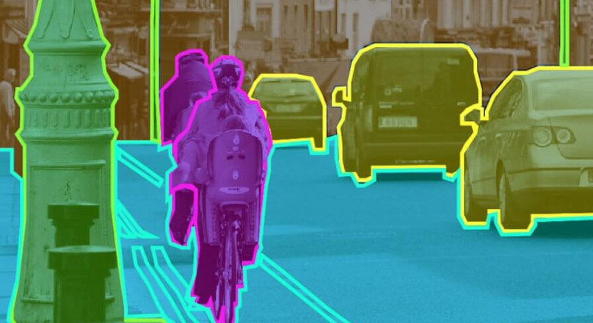
Many practical problems can be represented as a Map
Context
LLM
Next word
Image Segmentation
Segmentation mask
Image
Sentiment Analysis
Sentiment probabilities
Text
Speech Sample
Transcription
Transcribed Text

Slide 5
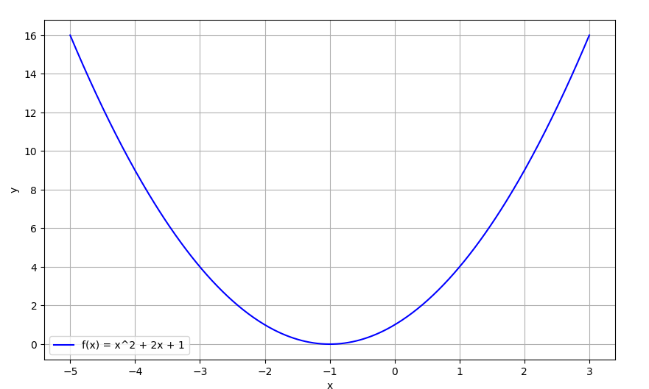
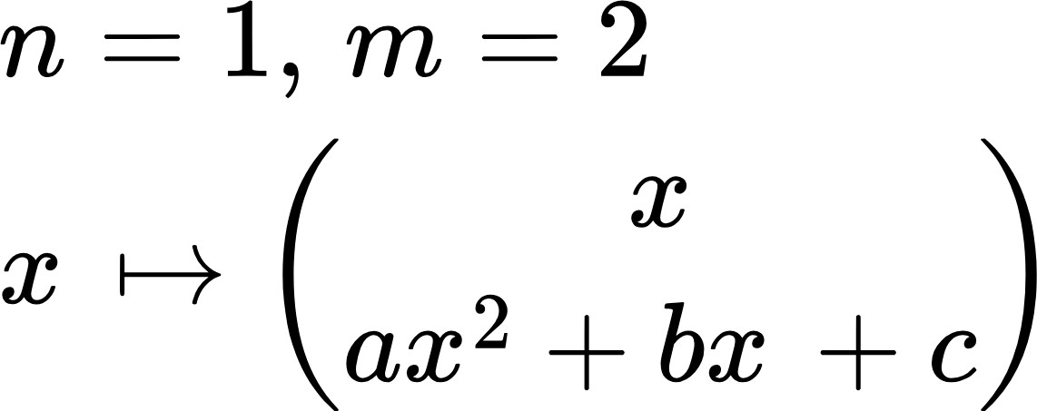
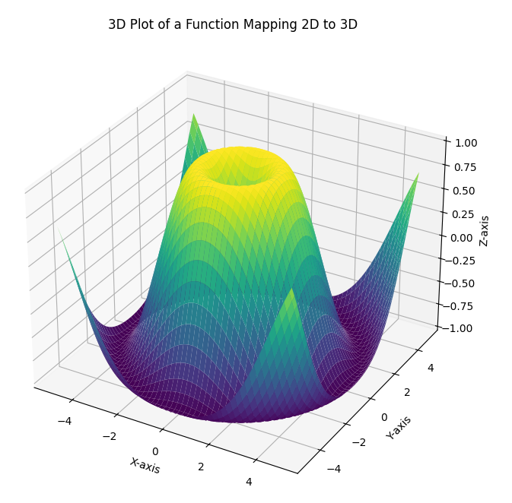
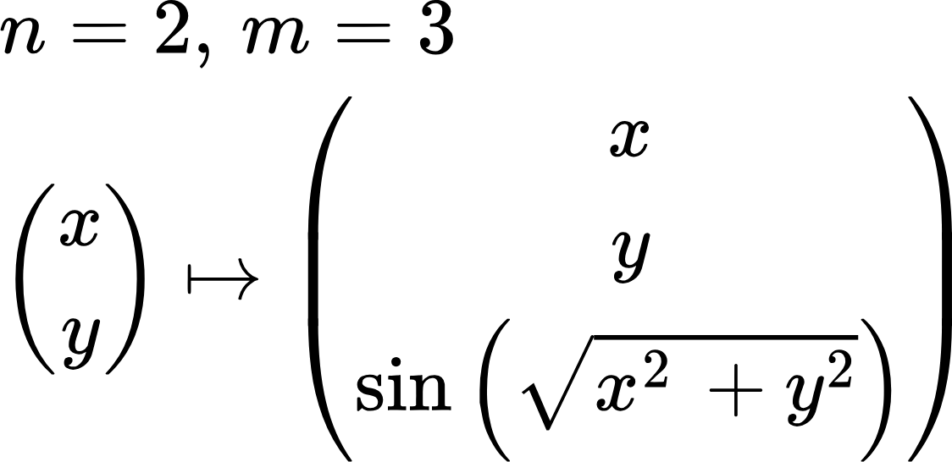
Maps are Functions in Math speak
In math, functions map a point in Rn to Rm.
What is a dimension? Number of things that can vary independently. Points along a line are 1D, on a plane: 2D, in space: 3D..
Mapping points along a line to a curve.

Slide 6
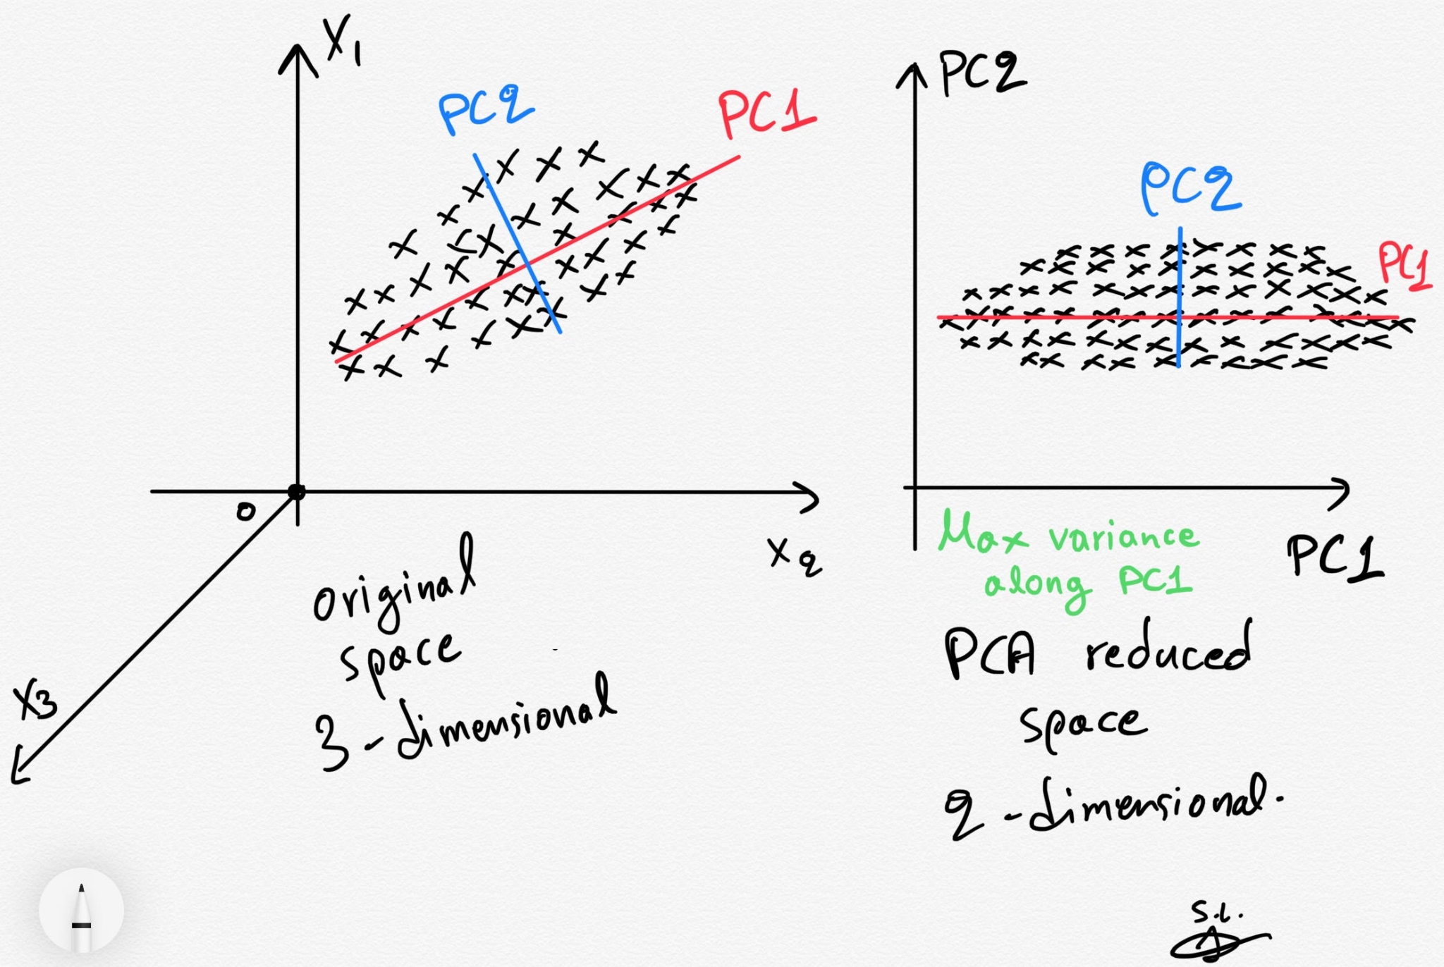
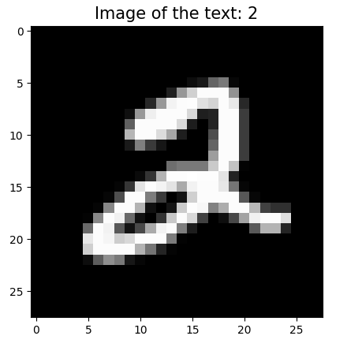
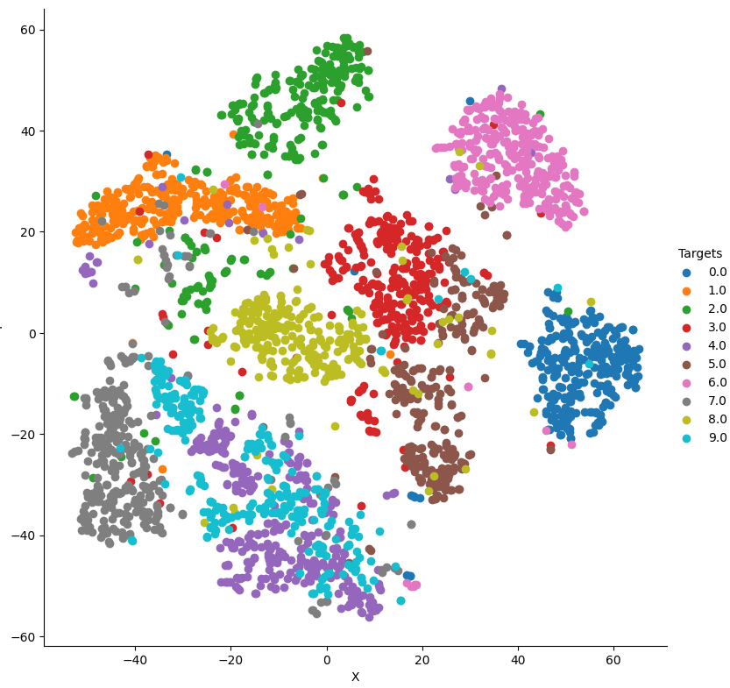
Functions = Maps
Some other examples..
PCA: Dimensionality reduction technique to preserve variation
t-SNE: Visualization technique to visualize vectors in high-dimensional spaces that preserves structure
Reshape to 784 * 1
t-SNE
Digit 2 from the MNIST dataset (28, 28, 256)
Code: mnist_t-sne.py

Slide 7

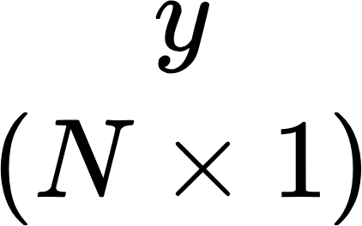
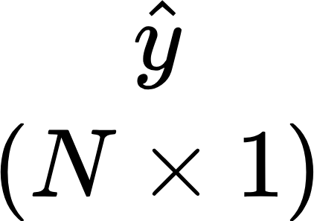
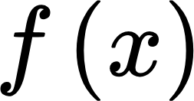
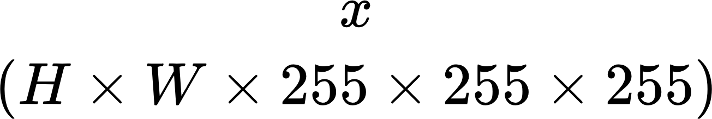
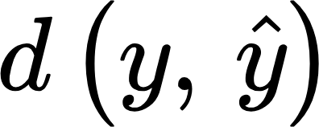
Functions = Maps
Case 1: Image Classification
Probabilities
Labels
1
0
0
0
Cat
0.6
0.05
0.06
0.01
Dog
Mapping
Number of classes
Chicken
Diff

Slide 8

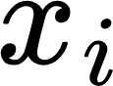

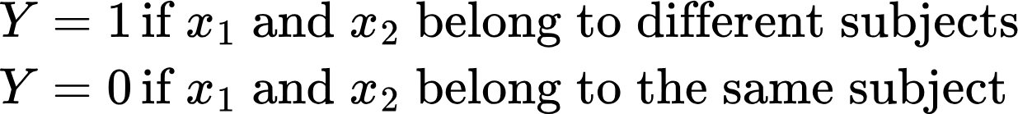

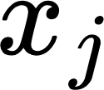
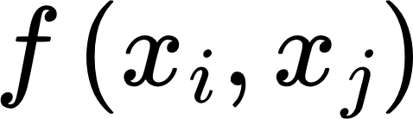

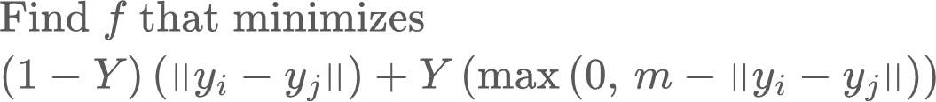
Functions = Maps
Case 2: Face Recognition
Subject 1
Mapping
Subject 2
When yi and yj belong to the same subject, we want to drive them as close as possible
When yi and yj belong to different subjects, we want to drive them as far as the margin m, but no farther.. To keep the task simple. m can then be used as the decision threshold

Slide 9
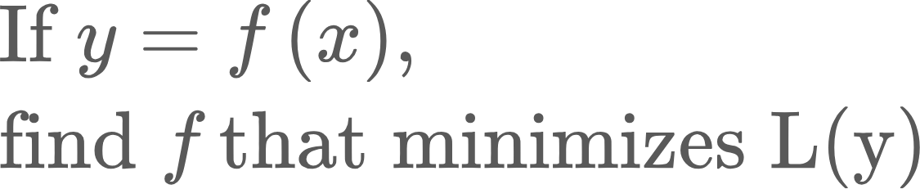
So we have an optimization problem!
Here, L(y) is called a Loss function. It measures the difference between output of the function f and some groundtruth (classification label, audio transcription)..
But.. f is some function in a high-dimensional space.. We don’t know its form--linear, quadratic.. number of parameters etc. All we have is input and desired output.
How can we learn an unknown function in a high dimensional space using relatively simple and scalable math?

Slide 10
Yes we can!
And that’s where neural networks come in!
Key ideas:
Map to higher dimensions: Complex relationships in lower dimensions can become tractable in higher dimensions
Concatenating linear functions with simple non-linear functions (eg, piecewise linear functions) can approximate any non-linear function
Learn from examples, rather than formulate rigid rules. What makes a cat a cat?

Slide 11
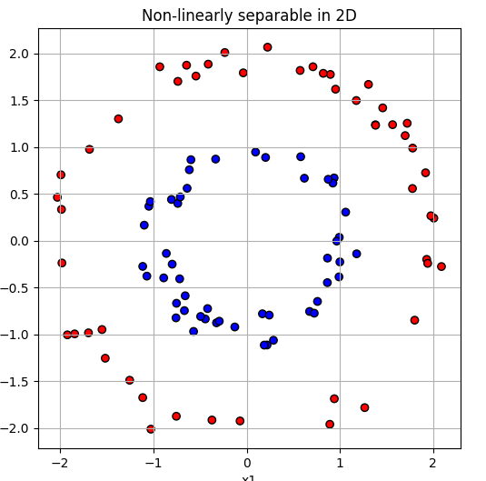
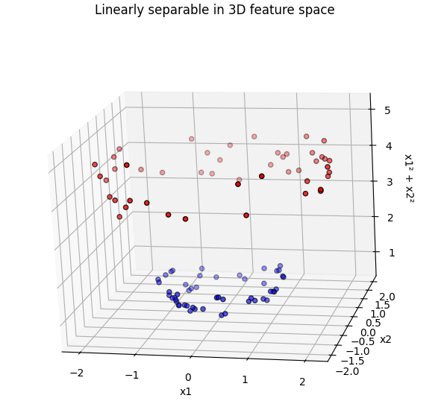
High dimensions can make things easier

Slide 12
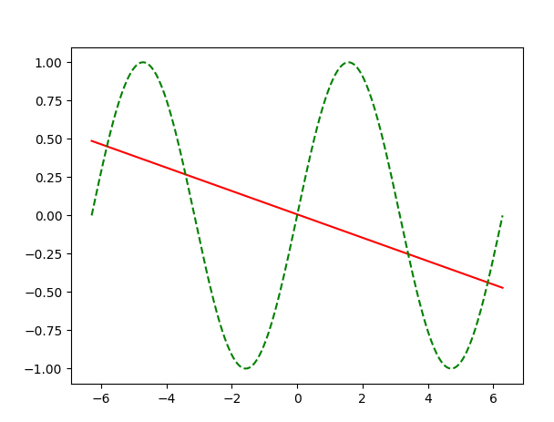
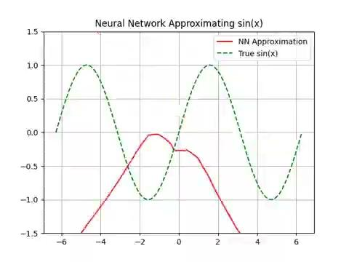
Concatenating linear functions and simple nonlinear functions can approximate any function!
We’ll soon learn how to build this!
The nonlinearity is key!
Without ReLU
With ReLU

Slide 13



Can you describe a cat?
Anyone can tell a cat from a dog.. But can you define what makes a cat a cat?
Defining rules is brittle, because nature (and us) likes to break rules.
Learning from examples is better, and let the “brain” figure out the rules
So what makes a cat a cat? Who cares.. I know a cat when I see it :-)
This is a cat
So are these
And this..

Slide 14
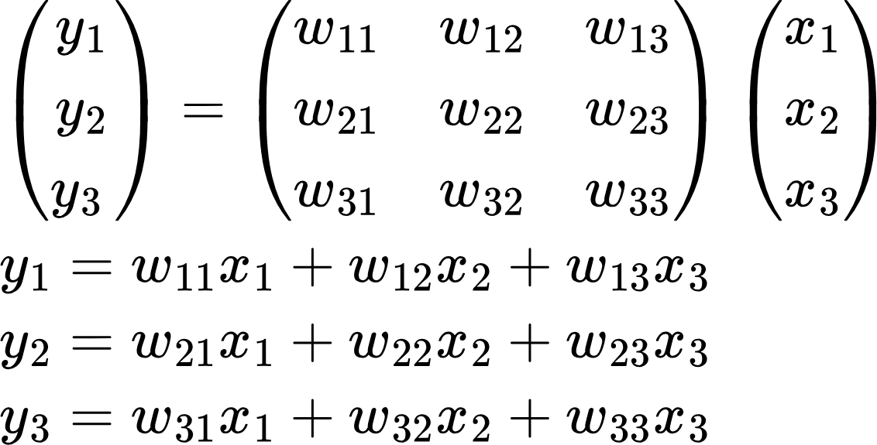
Some other desirable properties
Neural network calculations are simple and parallelizable
Most the calculations in a neural network are matrix multiplications
Each of the products can be calculated in parallel
That’s why GPUs are so popular in Deep Learning!
They are massively parallel (designed to draw pixels on the screen, a parallel calculation)
Programmable using CUDA
Each of the y’s can be calculated in parallel

Slide 15
An interesting aside..
Is AI something new or an incremental advance?
Neural Networks, the workhorse of AI were invented in 1943.. But their true capabilities were never realized, because they remained “shallow” (1-2 layers)
Aha moment arrived in 2012. Alex Krizhevsky, Ilya Sutskever, and Geoffrey Hinton from U of Toronto won the ImageNet Large Scale Visual Recognition Challenge (ILSVRC) in 2012 using a 8 layered Neural Network, that significantly outperformed the competition
Rediscovery of Backpropagation
Dropout to prevent overfitting..
Algorithmic Advances
AI Revolution
Large Datasets
Large, high-quality labeled datasets such as ImageNet
Programmable GPUs
Highly efficient GPU implementation of matmul, convolution etc
https://proceedings.neurips.cc/paper_files/paper/2012/file/c399862d3b9d6b76c8436e924a68c45b-Paper.pdf

Slide 16
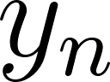
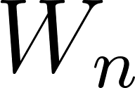
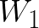
Structure of a Network
Forward Pass or Inference
labels
ReLU
Loss function
Error
…
Backward pass or training
Points on a 2D space
Sequence of embeddings
Fourier transform coefficients of an audio sample
Images
Image patches
Video frames..
Key question: How do I adjust the weights to reduce error?
Answer: Backpropagation!

Slide 17
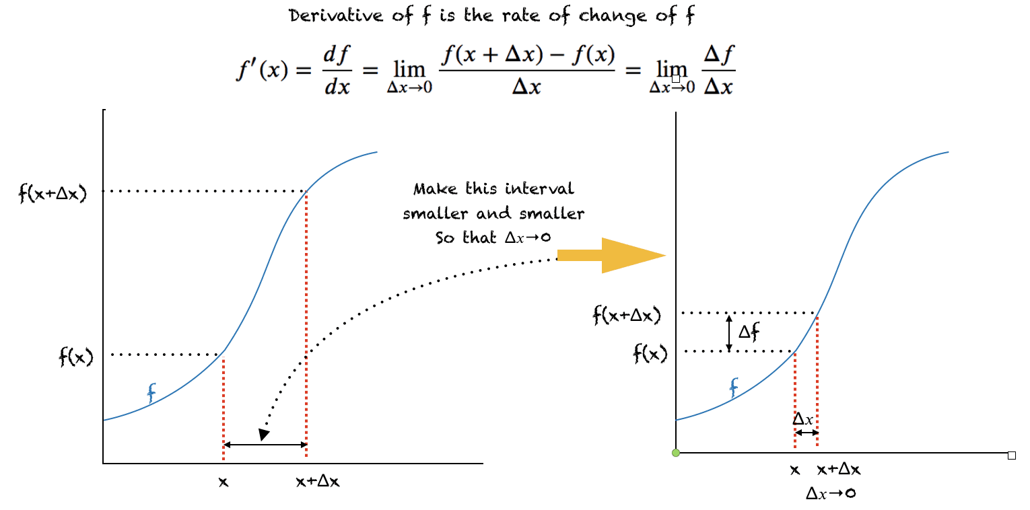

Some basic math..
As gets smaller, the derivative approximates the slope of the tangent where the derivative is calculated

Slide 18
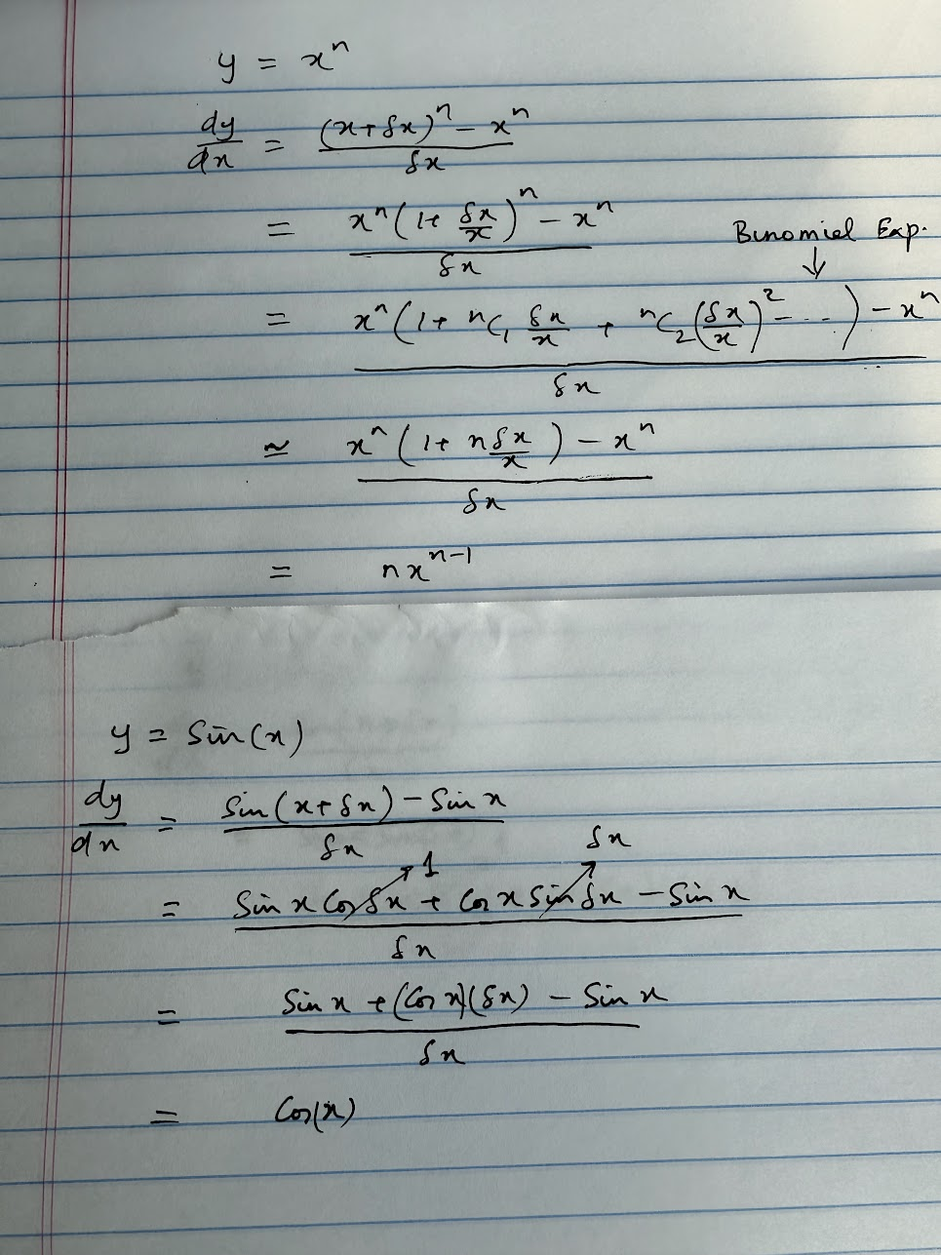
Some examples..
delta_x: 0.00, derivative: 4.00
delta_x: 0.05, derivative: 4.31
delta_x: 0.10, derivative: 4.64
delta_x: 0.15, derivative: 4.99
delta_x: 0.20, derivative: 5.37
delta_x: 0.25, derivative: 5.77
delta_x: 0.00, derivative: 2.00
delta_x: 0.05, derivative: 2.05
delta_x: 0.10, derivative: 2.10
delta_x: 0.15, derivative: 2.15
delta_x: 0.20, derivative: 2.20
delta_x: 0.25, derivative: 2.25
Intuition: Derivative approximation becomes less accurate more quickly for faster changing functions..

Slide 19
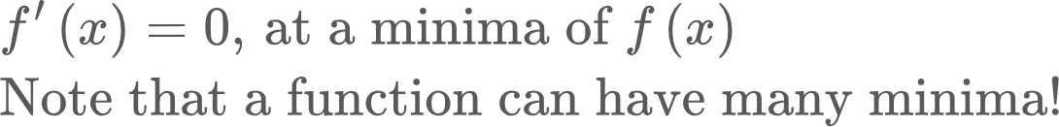
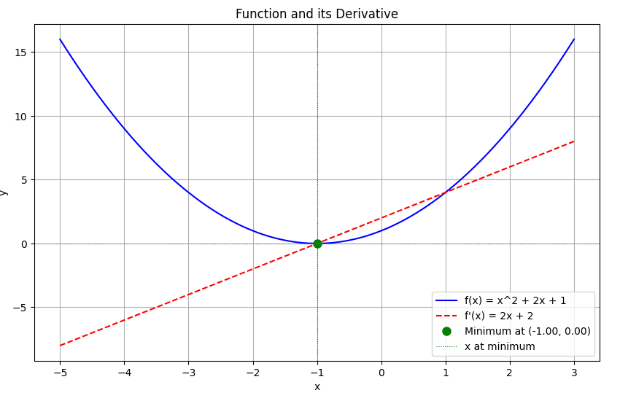
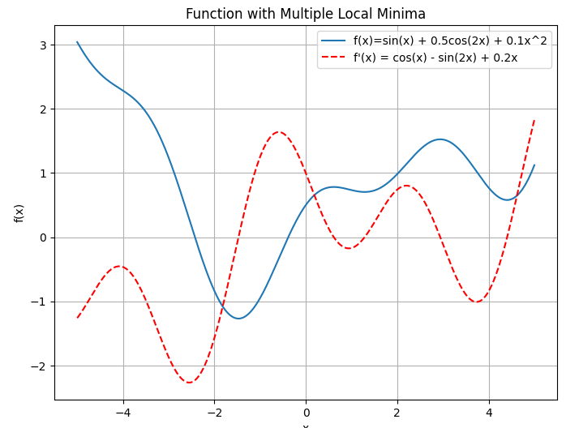
Derivative: Important property
Makes sense, because derivative of a function at a point is the slope of the function at that point, and the slope must be zero at a local minima
Code: multiple_local_minima.py

Slide 20
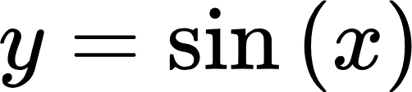
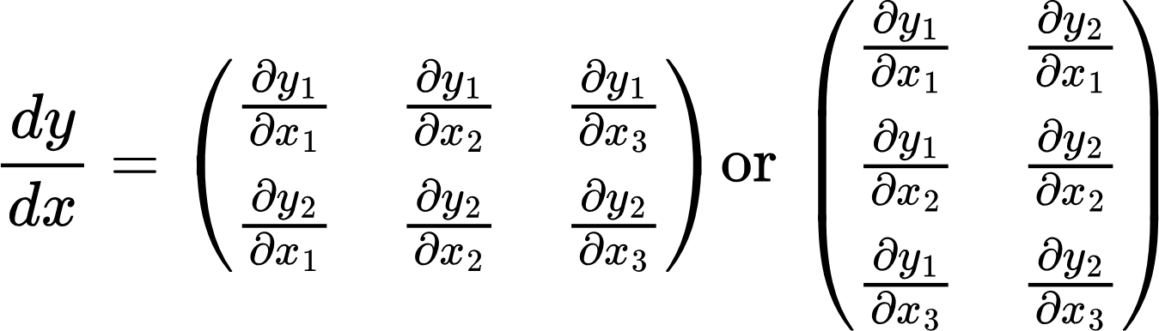
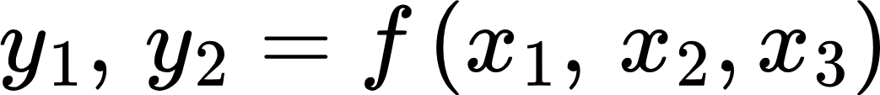
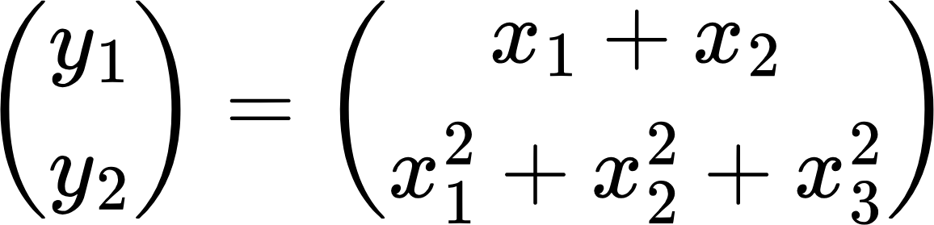
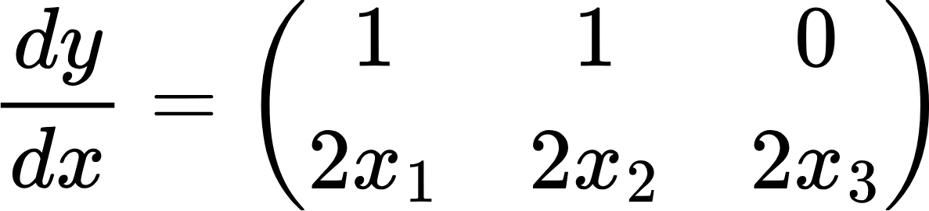
Derivative of multivariate functions
Here, x and y are univariate. But they can also be multivariate
y
x
Example:

Slide 21
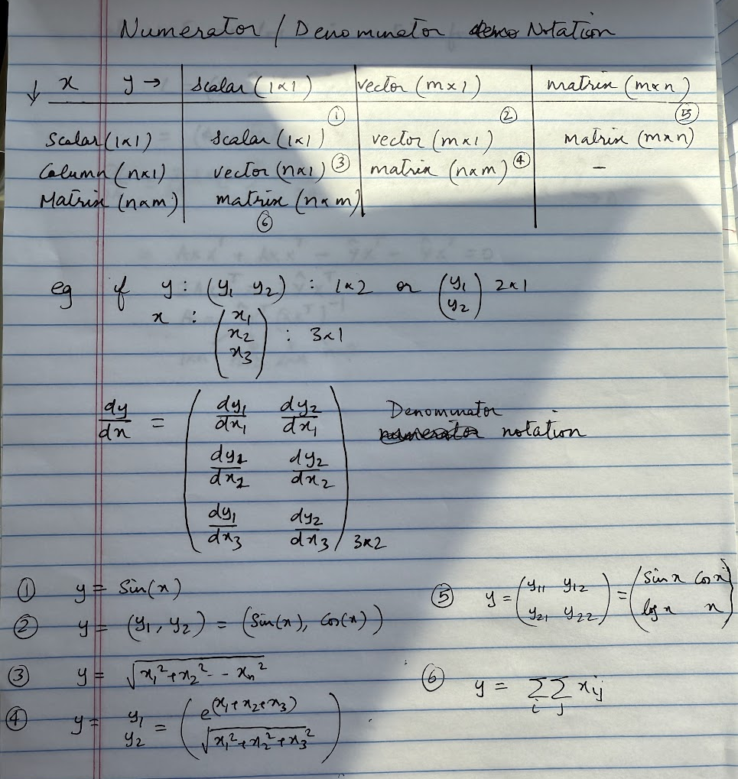
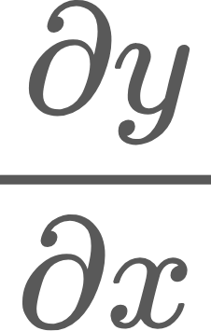
Partial Derivative Layouts
Numerator vs Denominator notations
When y is a vector and x is a scalar, then follow y’s dimensions
https://en.wikipedia.org/wiki/Matrix_calculus

Slide 22
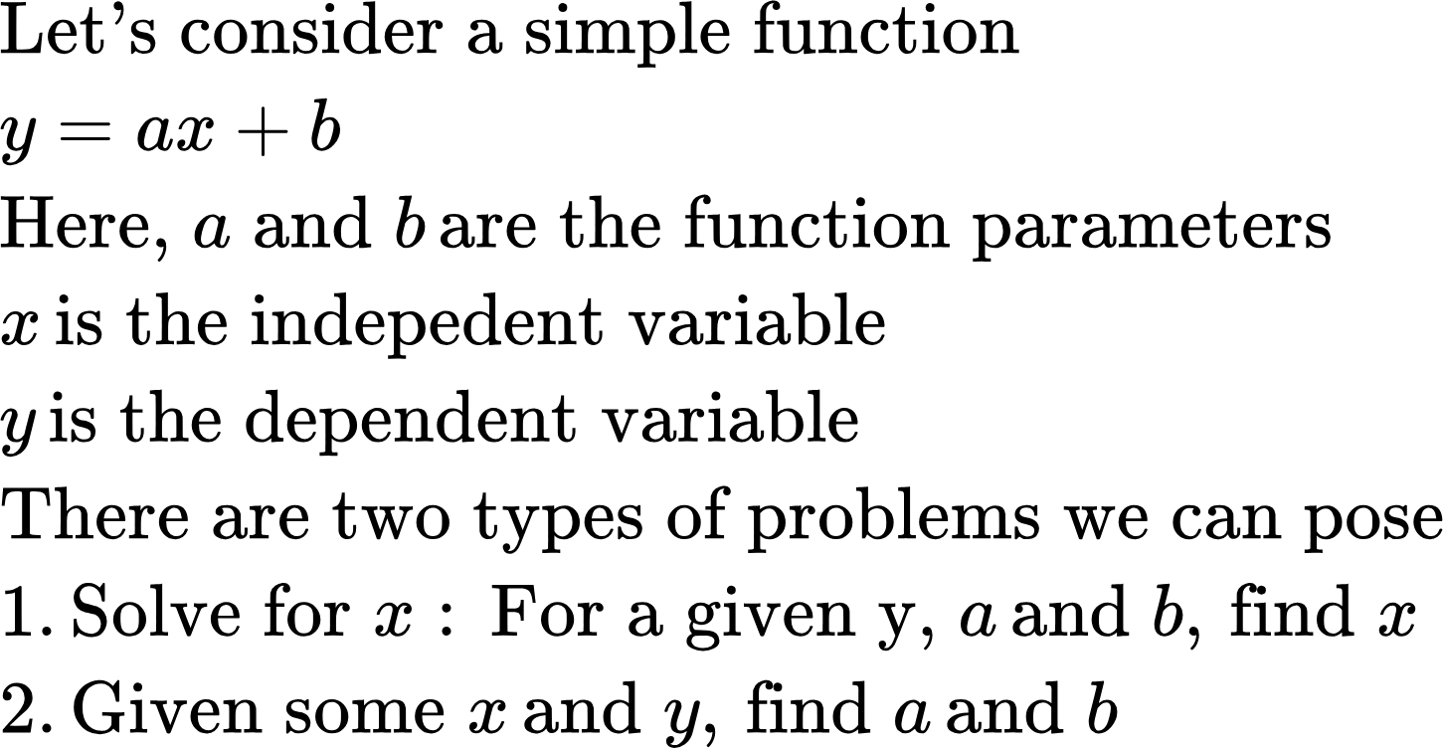
Let’s come back to the optimization problem

Slide 23
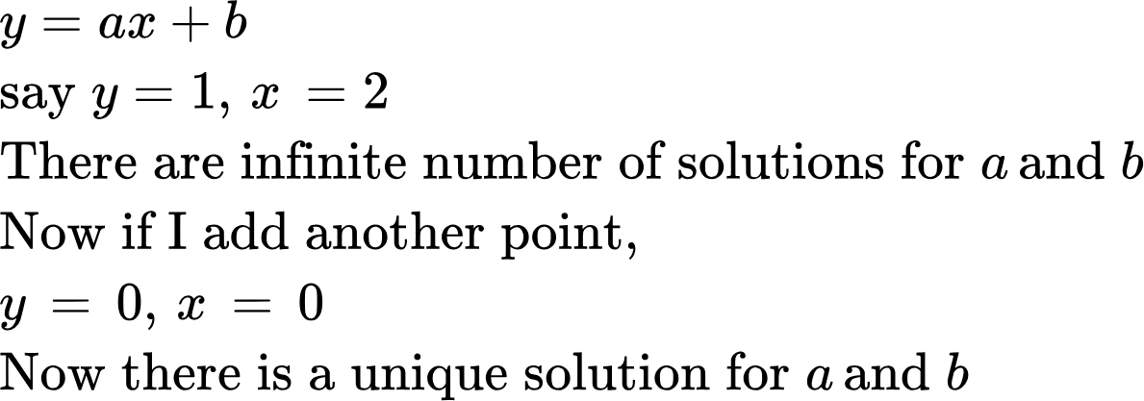
Let’s come back to the optimization problem
Optimization deals with problem 2.
Let’s consider an example
What if there are several points? Now, the best we can do is to find a and b that minimize some distance metric between the points and the line defined by a and b

Slide 24
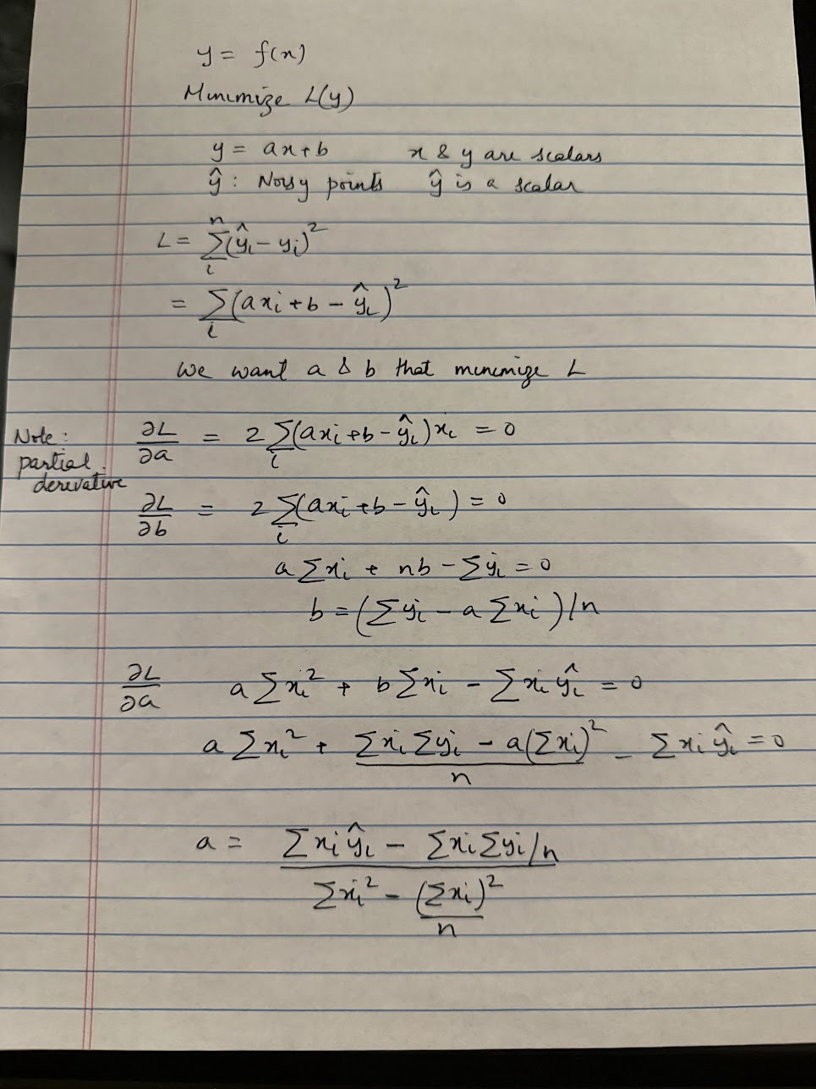
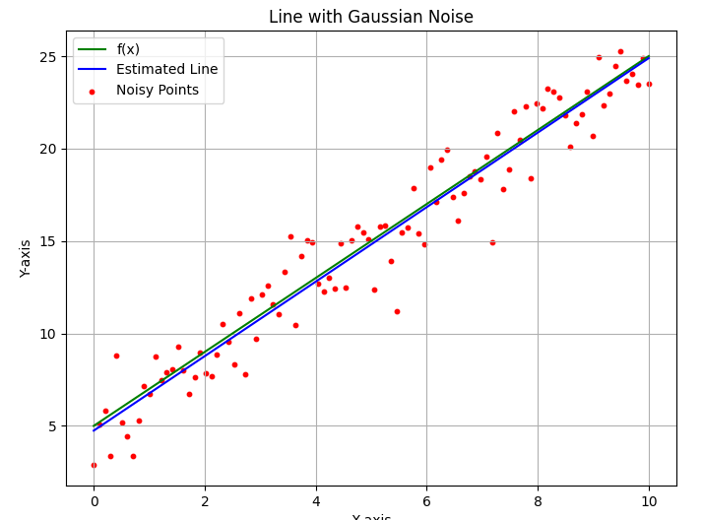
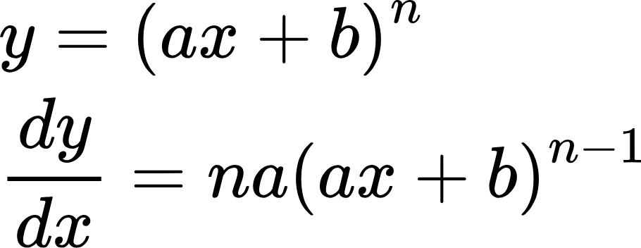
Optimization Example
Let’s now use derivatives to solve a common optimization problem.. Linear regression
Code: linear_regression.py

Slide 25
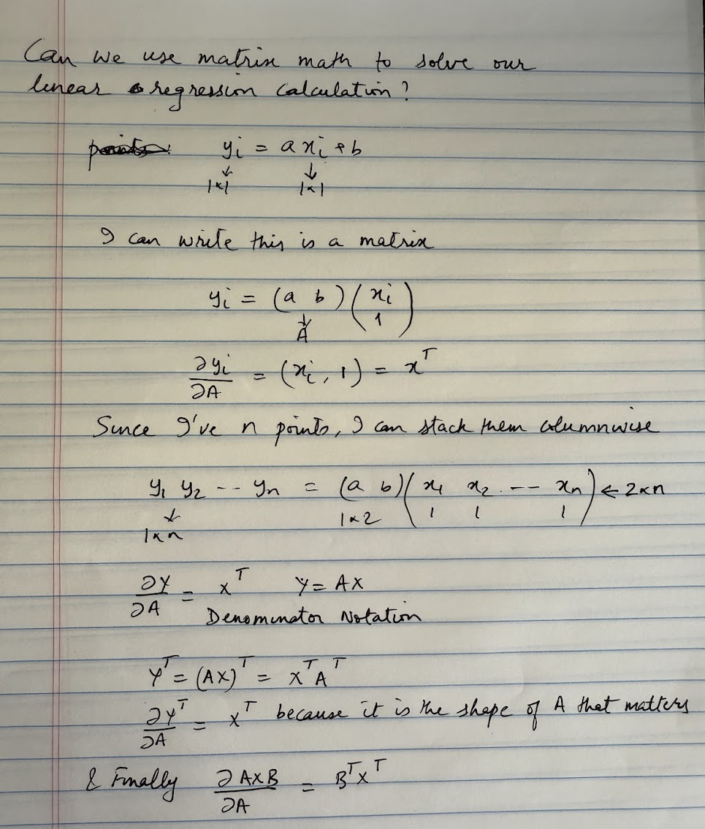
Using Matrix Math..

Slide 26
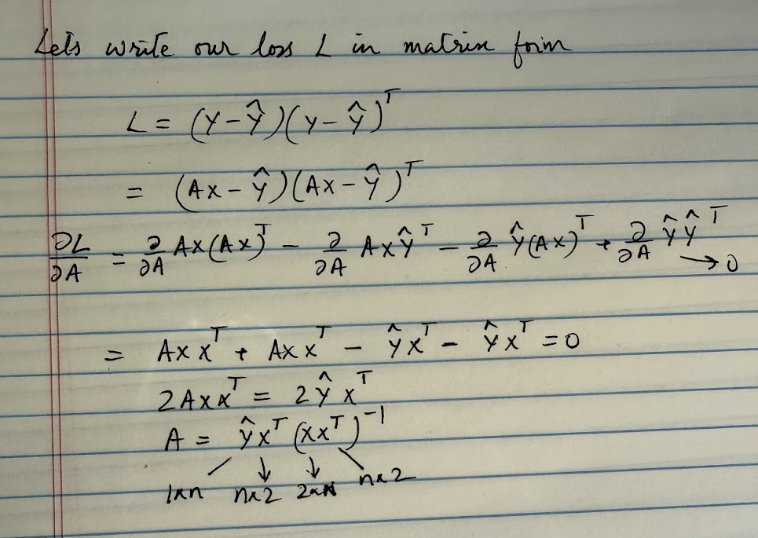
Using Matrix Math..
Code: linear_regression.py

Slide 27
Using Matrix Math..
What if the error function is absolute value? HW problem..
Code: linear_regression.py

Slide 28
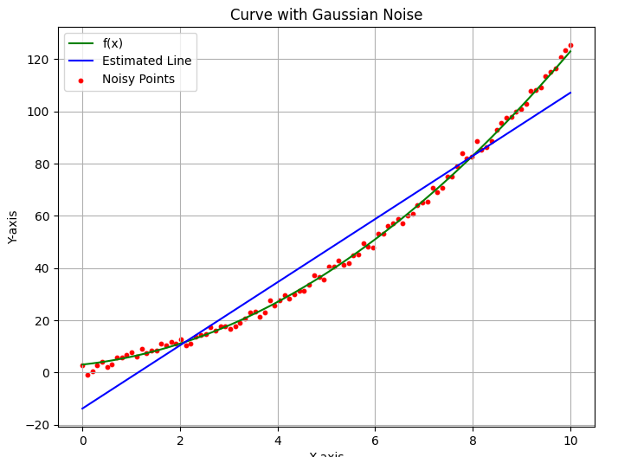
Limits of linear regression..
Trying to fit a linear function to points around a quadratic function will naturally result in higher errors..

Slide 29
Recall: Structure of a Network
Forward Pass or Inference
labels
ReLU
Loss function
Error
…
Backward pass or training
Points on a 2D space
Sequence of embeddings
Fourier transform coefficients of an audio sample
Images
Image patches
Video frames..
Key question: How do I adjust the weights to reduce error?
Answer: Backpropagation!

Slide 30
Homework problems

